Slide 1
Social Media in Anchorage
Heather Roach
Senior Communications Specialist
Anchorage School district
Notes:
Hello
Explain my background and what I do for ASD

Slide 2
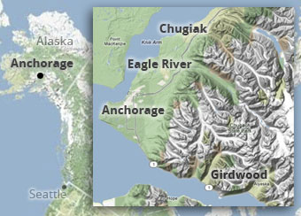
About ASD
More than 48,000 students
District encompasses almost 2,000 square miles
Larger than state of Rhode Island
Minority students comprise more than 50% of student population
91 languages are spoken among our students
Top languages (aside from English)
Spanish
Hmong
Samoan
Tagalog
Yup’ik

Slide 3
ASD social media presence
Facebook
Launched in 2009
Almost 18,000 likes
Used to share news, announcements and feel-good stories that might otherwise not be featured in the media or other avenues
Twitter
@ASD_Info
Used to share news and announcements
More than 4,200 followers
@ASD_Closures
Used to broadcast closure notices only
More than 4,500 followers
YouTube
@AnchorageSD
Notes:
Talk about our different accounts
Why we chose these platforms
We go where our audience is and this is where our stakeholders are
Talk about our challenge with YouTube vs. streaming on our website

Slide 4
Account management
Communications Department has 3 staff admins for Facebook and Twitter
Two staffers do all of the posting, one is lead for each platform
Exec Director serves in supervisory role and backup
ASD-TV videographers populate the YouTube channel
In consultation with social media staff
Student videos – copyrighted material
Notes:
Talk about how we manage our accounts, who does what and why

Slide 5
How we use Facebook
ASD uses Facebook as one of our primary communications tools
Large reach: Almost 18,000 fans
Use for:
School closures
Districtwide events
Feel-good stories that would be overlooked by local media
Celebrating student achievements
Interacting and asking questions
Notes:
Give general overview of how we use Facebook

Slide 6
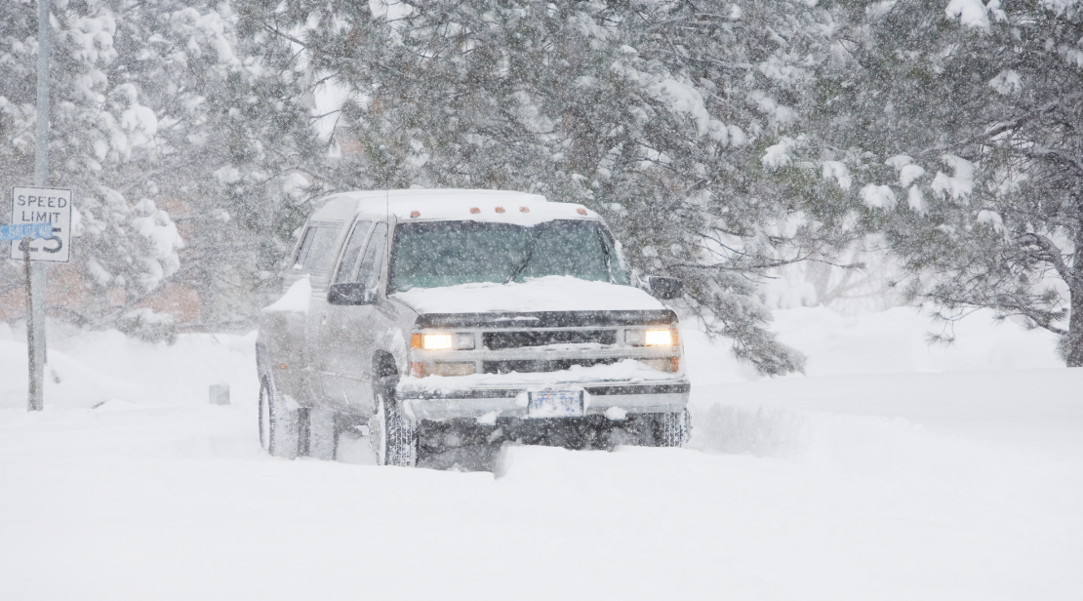
Weather-related closures
Social media is a primary tool for communicating last-minute school closures
Example of having a very short amount of time to communicate important message to entire community

Slide 7
Closure procedures
Superintendent makes final decision by 5 a.m.
Communications staff must complete all closure notification procedures by 5:30 a.m.
Procedures:
Update website home page with prominent red banner message
Send news release
Post on Twitter closures account, RT to info account and post on Facebook
Change ASD-TV bulletin
Record phone message for main switchboard number
Make personal calls to TV and radio stations asking for help in getting the word out
Notes:
I’ll talk briefly about how we communication closures to our community (this will give context to the social media aspect of it).

Slide 8
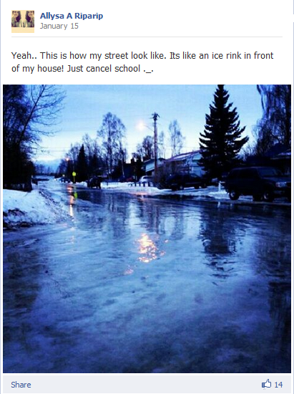
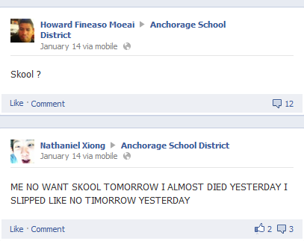
Questions overdrive
Despite clearly-communicated procedures, questions inundate our page
Our fans don’t hesitate to tell us when they want school canceled
Notes:
Despite posting that schools are closed, we will continue to receive questions throughout the day. Other people’s posts often receive a lot of traction from other users chiming in.

Slide 9
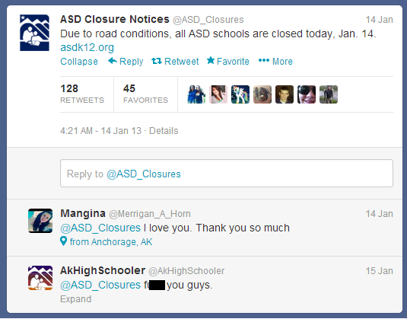
Tempers high when it comes to closures
Example of hostility on closure days
Notes:
Great example of how emotions can run high and low on closure days. I’ll mention that @AKHighSchooler did in fact get blocked after his/her tweet to us – not because of the negative feedback, but because of the bad language. We also get a lot of “If I die on the roads it’s ASD’s fault” type of posts.

Slide 10
Challenges
Students turned our wall into a chat room
Profanity was rampant
Despite having tight profanity controls, misspelled cuss words and slurs were slipping through
Superintendent was receiving complaints about our page from staff and parents
Content from users was offensive
We suspended all comments and wall posts for a few days and posted a note about our Facebook policies
Monitoring at all hours of night
Notes:
I’ll talk about the time students turned our page into a chat room, treating every post as a place to have real-time chats about off-topic, profanity-laden subjects. The superintendent (Comeau at the time) received several emails from ASD staff and community members saying they were offended by the content on our page.

Slide 11
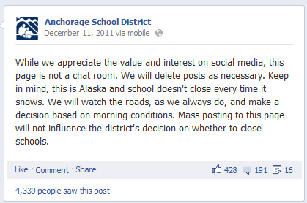
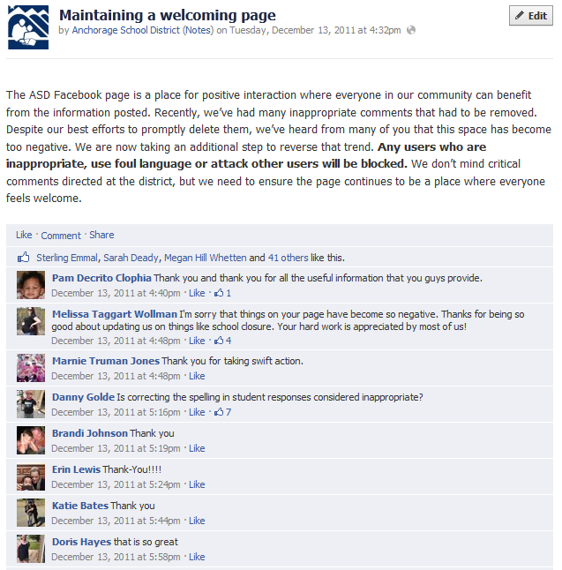
Notes:
Show how we dealt with the situation. Point out positive response we got from our Facebook note.

Slide 12
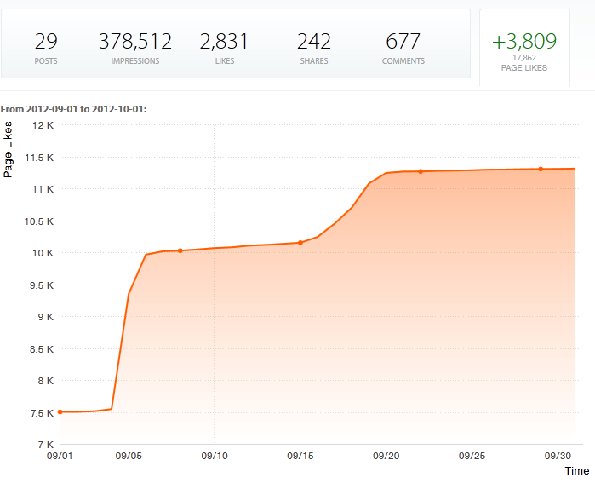
Closures have generated more users
Facebook:
Month of September 2012
Major wind storm occurred on Sept. 5
Twitter closure account:
Increased followers by 428 people
Notes:
Show how our account popularity is effected by weather issues.

Slide 13
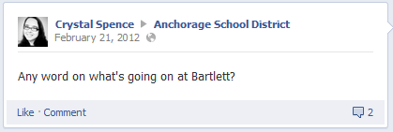
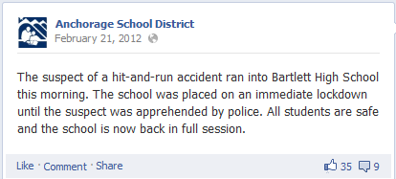
Police activity
Another way we use social media is to notify why there might be police cars near our schools or why schools go into lockdowns
Often times parents will see police activity and post on our wall asking what’s going on
Notes:
We use social media for “emergency” situations – and most of the time we are telling people that what is happening isn't an emergency.

Slide 14
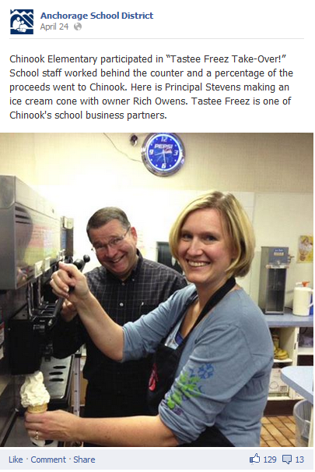
Highlight our School Business Partners
ASD has robust School Business Partnership program
More than 540 partnerships with businesses and military
Highlight partnership activities with photos and descriptions
Enhances partnership
Use it as an opportunity to say thank you
We do not post coupons or offers
ONLY school partnership activities
Notes:
Another way we use Facebook is to build our community relationships.

Slide 15
How we use Twitter
We leave the storytelling to Facebook, use Twitter for news
Weather-related closures
Separate Twitter account just for closures
News posts that connect people to relevant resources
Important date reminders
RT community/gov organizations that work closely with district
Notes:
Overview of how we use Twitter.

Slide 16
Closures on Twitter
Separate account just for closures
Weather/emergency-related closures
Holiday-related closures
In-service days
Notes:
I already talked about weather closures, but I will mention how we use the @ASD_Closures account for non-weather closures and site-specific closures.

Slide 17
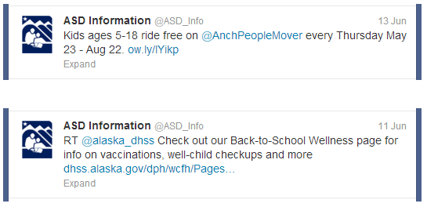
Share important info from others
Retweet community/gov organizations that work closely with district or whose programs benefit parents/students

Slide 18
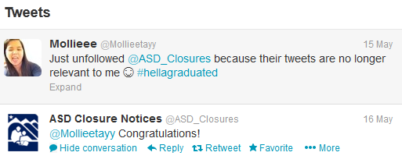
“Why are we losing followers?”
In May, we lost about 15 followers on our Closures account
Boss asked why we were losing followers all at once
Because of graduating students like this one:

Slide 19
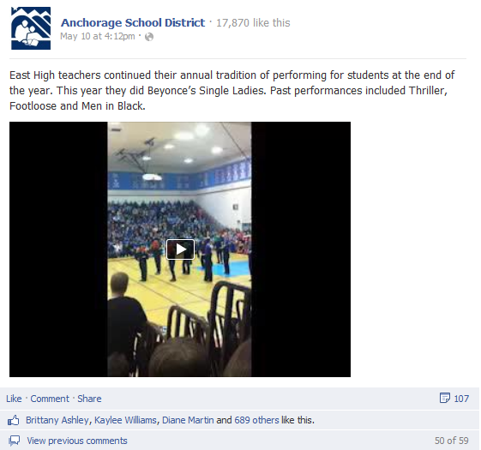
What do people like best?
Our fans like fun stories
Notes:
I’ll show the stats for some of our most viral posts. This video received the most impressions of any Facebook post we’ve ever done. I’ll also take the opportunity to talk about how Facebook can and should be used for so much more than just a place to post news.

Slide 20
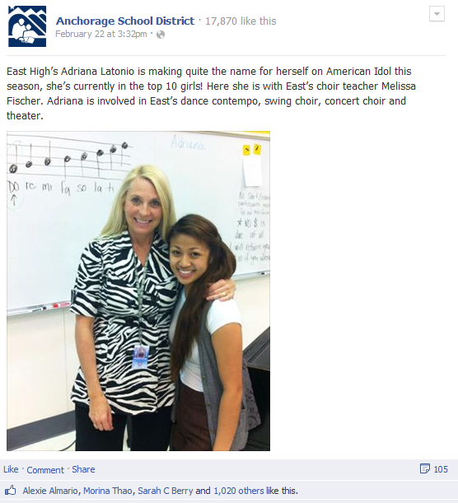
What do people like best?
Notes:
Another popular one. I will also mention the perks of having our students (teens) following our page and the dynamic they bring.

Slide 21
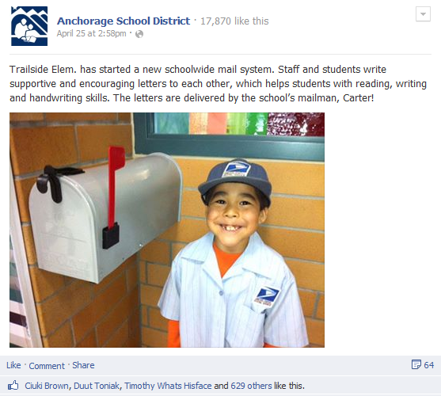
What do people like best?

Slide 22
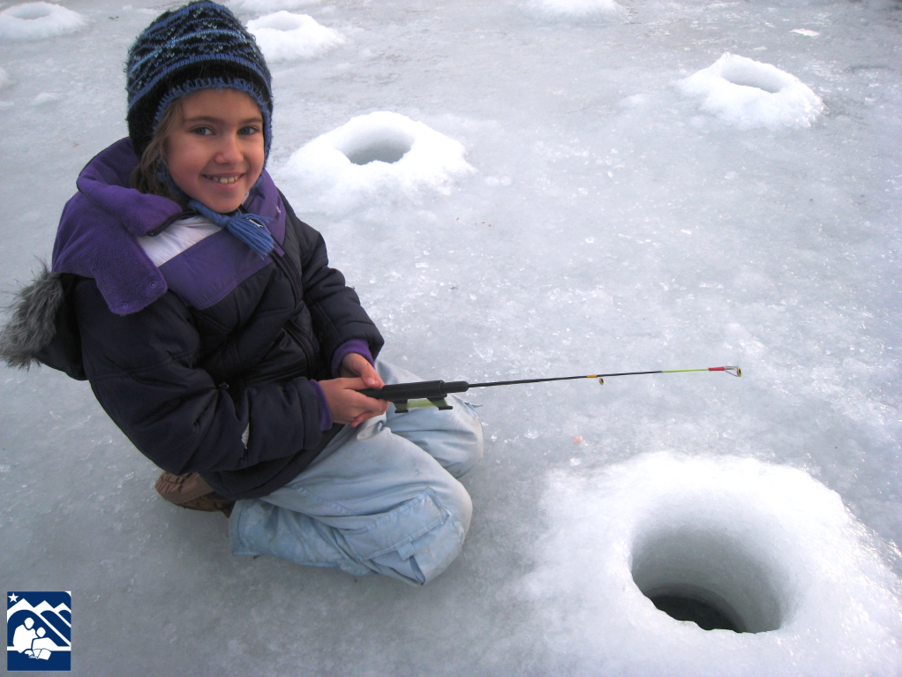
Thank you
Notes:
I know this pic is off topic, but it’s a cute example of the type of field trips our kids get to go on :)

